Slide 1
OOP LAB MINI PROJECT
Hospital Management System
Group 11
Evan Chemmannur
Chris John
Chris Issac
Chris Paul
Gokul
Francis Job

Slide 2



Project Objectives
Digitize Registration
OOP Concepts
Persistent Storage
Modern management of hospital patients.
Functional implementation of Java classes.
Data retention via Java file handling.

Slide 3



Technical Specifications
Language
GUI Framework
Java 17+
Java Swing (JFrame, JPanel)
Data Storage
Architecture
Object Serialization I/O
Encapsulated OOP Classes

Slide 4
Implemented Features
01. Registration
02. Validation
03. Record View
04. Persistence
Captures Name, Age, and Condition.
Strict integer parsing and blank-checks.
Non-editable structured table layout.
Automated loading from local file.

Slide 5

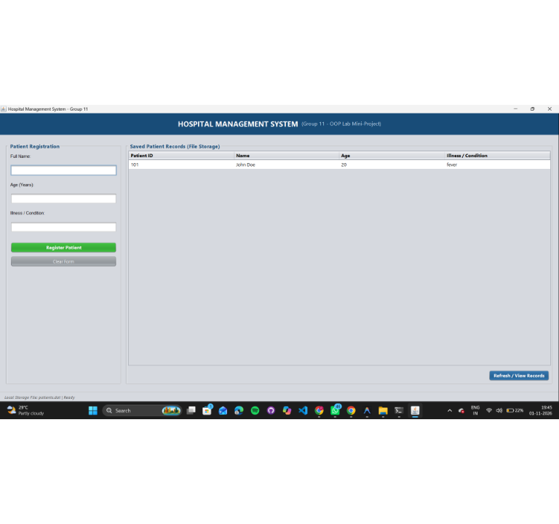
Application Interface
Live demonstration of the Swing GUI registering and displaying a patient.

Slide 6


Conclusion
Successfully applied OOP concepts to real-world problems.
Demonstrated functional integration of Swing & local persistence.
Provides a scalable foundation for future JDBC upgrades.

